Slide 1
EVALUATION Dr. Farhan hassan khan
MACHINE LEARNING

Slide 2
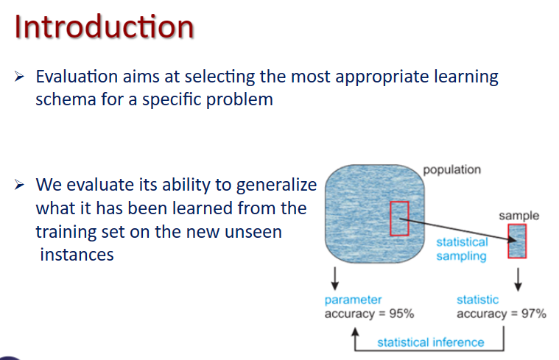
introduction

Slide 3
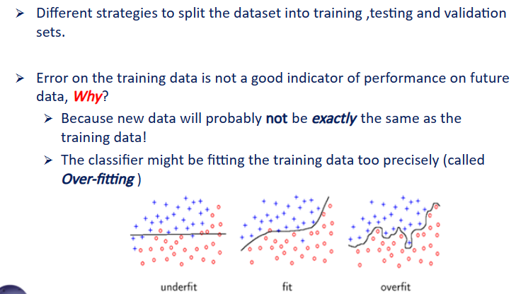
Evaluation strategies

Slide 4
Types of Datasets
Training Set:
Used to train the model.
2. Validation Set:
Used to optimize model parameters.
3. Test Set:
Used to get an unbiased estimate of the final model performance.

Slide 5
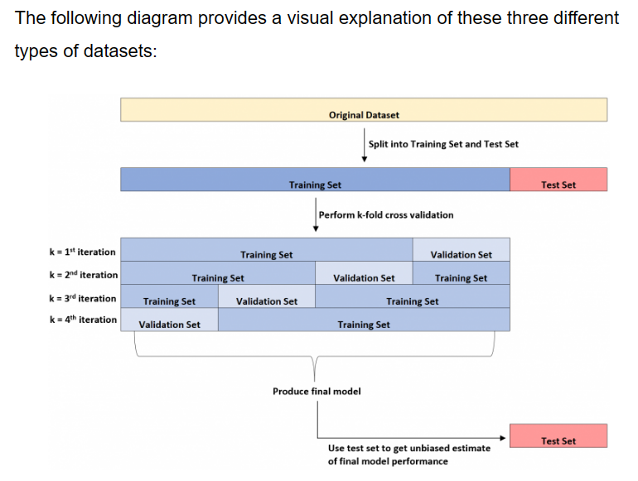
Types of Datasets

Slide 6
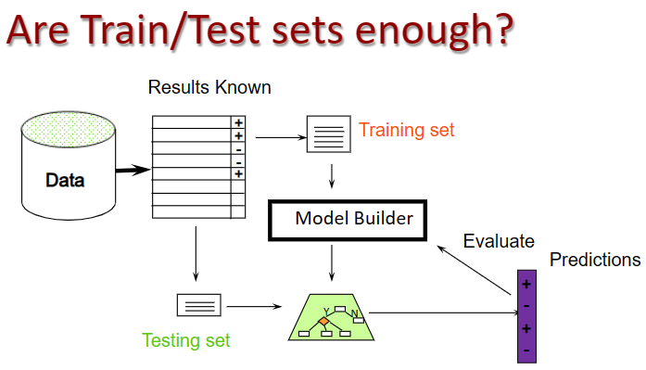
Train/Test sets

Slide 7
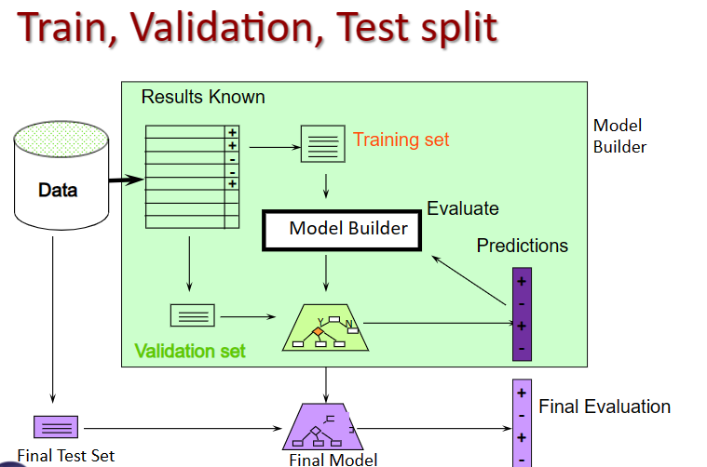
Train, Validation & Test sets

Slide 8
Methods of Estimation
Re-substitution
Leave one out method
Hold out method
Cross validation method
Bootstrap

Slide 9
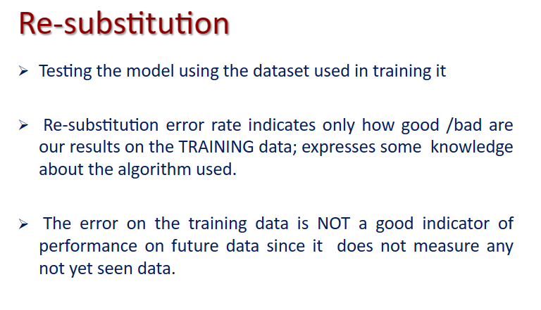
Methods of Estimation

Slide 10
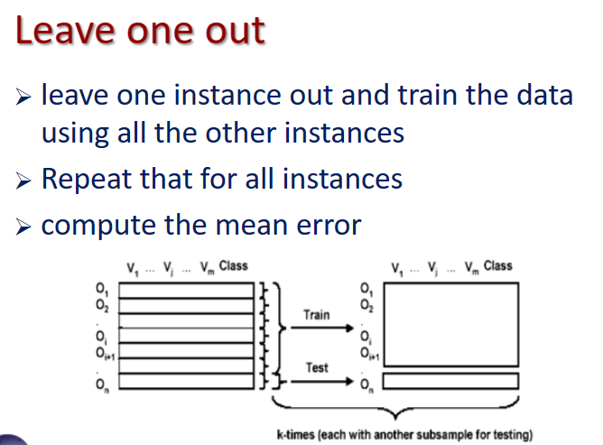
Methods of Estimation

Slide 11
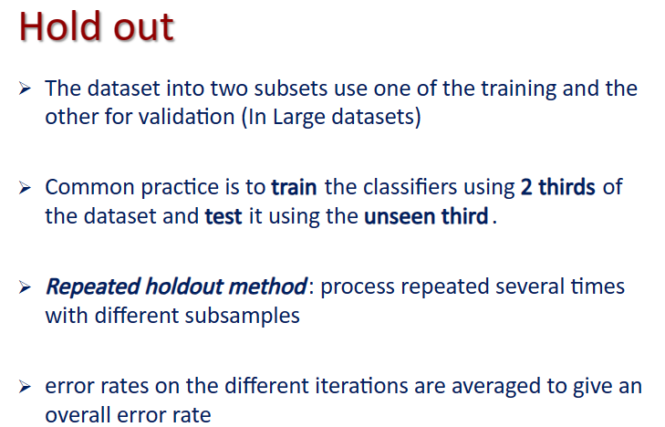
Methods of Estimation

Slide 12
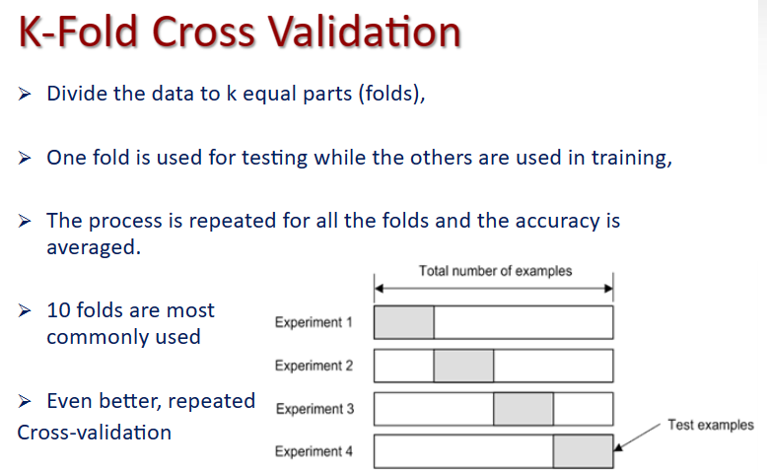
Methods of Estimation

Slide 13
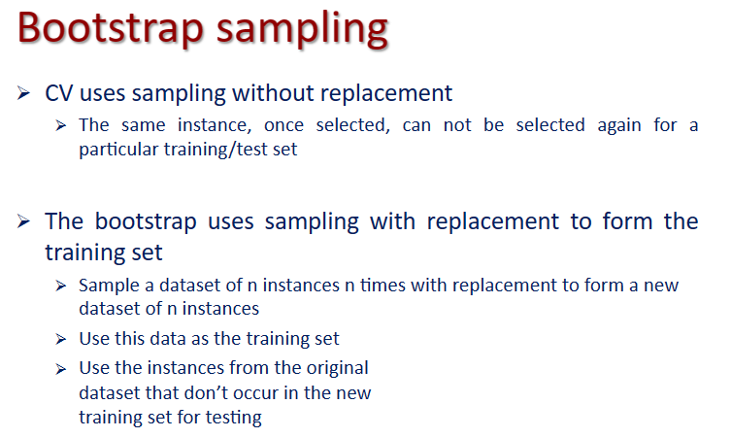
Bootstrap sampling

Slide 14
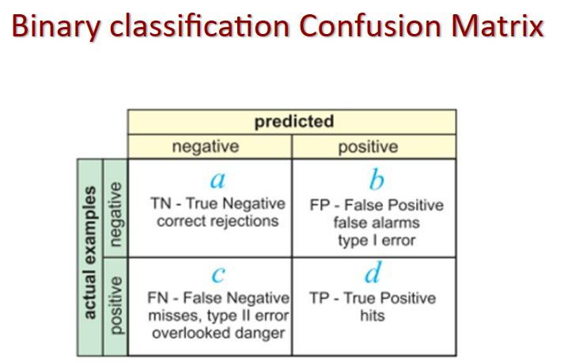
Confusion Matrix

Slide 15
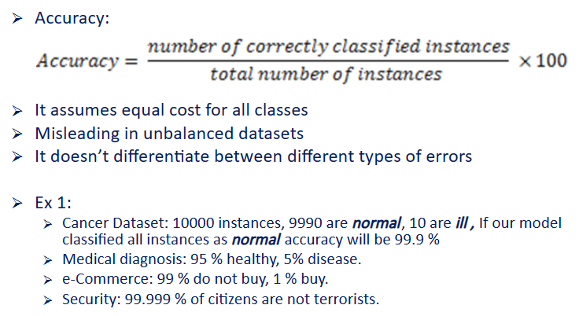
Evaluation Metrics

Slide 16
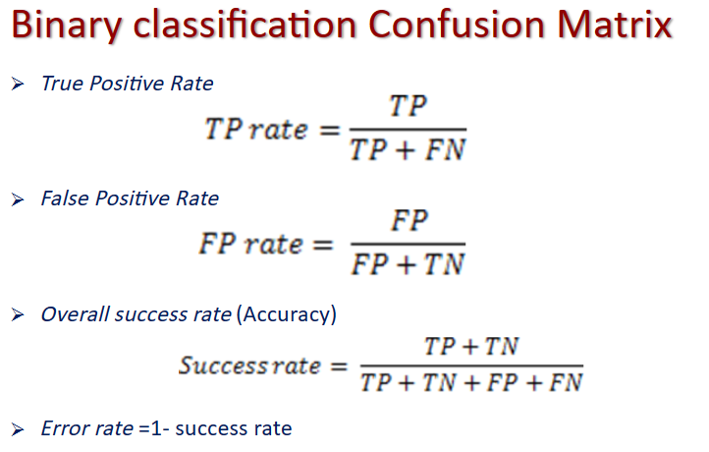
Binary classification confusion matrix

Slide 17
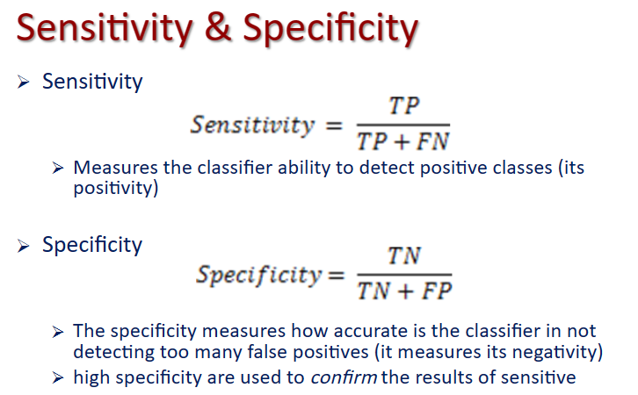
Sensitivity and specificity

Slide 18
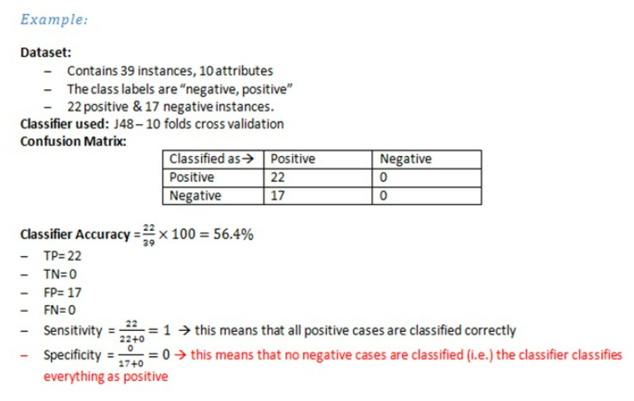
example

Slide 19
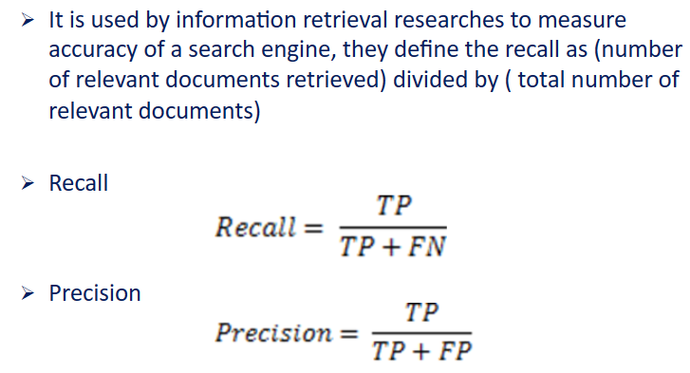
Precision and recall

Slide 20
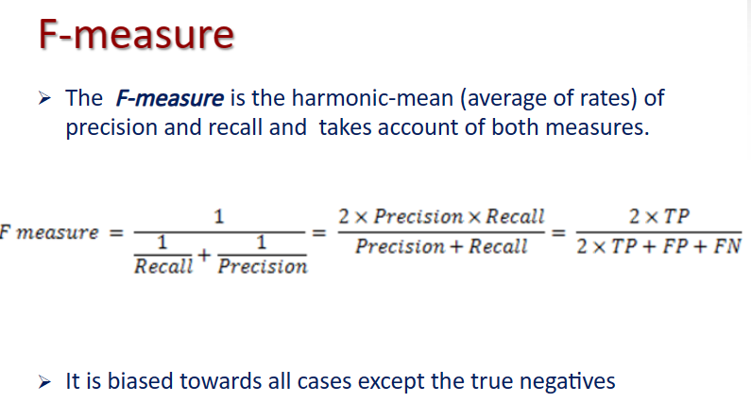
F-measure

Slide 21
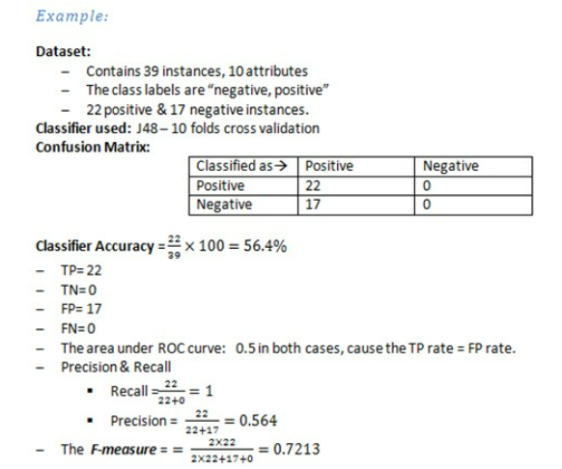
Example

Slide 22
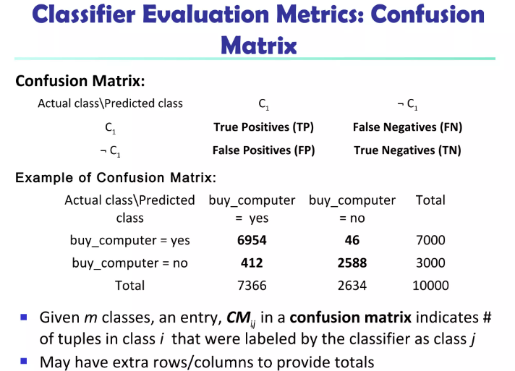

Slide 23
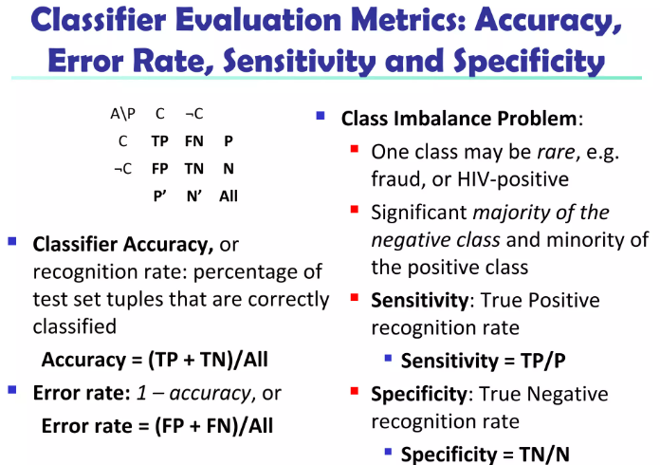

Slide 24
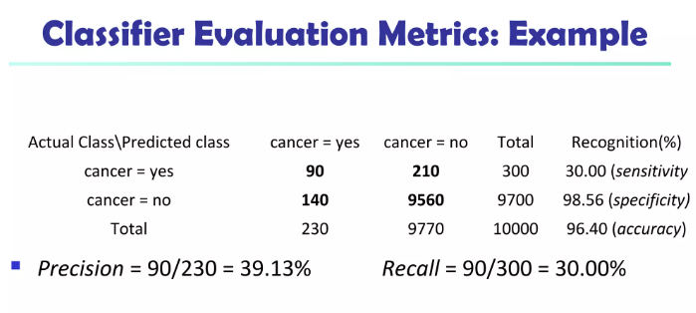

Slide 25
End of lecture

